Slide 1
COVID19 Classification Project
Chao Wang, Steven Wu, Brian Wu

Slide 2
Introduction
Objective: Identify potential biomarkers and therapeutic targets for COVID-19 through the analysis of proteomic and metabolomic data from patient serum samples.
Input: Proteomic and metabolomic data obtained from serum samples of COVID-19 patients.
Proteins: 402
Peptides: 101,461
Metabolites: 941 biochemicals
Output: A list of potential biomarkers and therapeutic targets for COVID-19.
Classification categories:
COVID-19 symptoms: Non-severe-COVID-19 and Severe-COVID-19 samples.
No COVID-19 symptoms: Healthy and Symptomatic-non-COVID-19 samples.

Slide 3
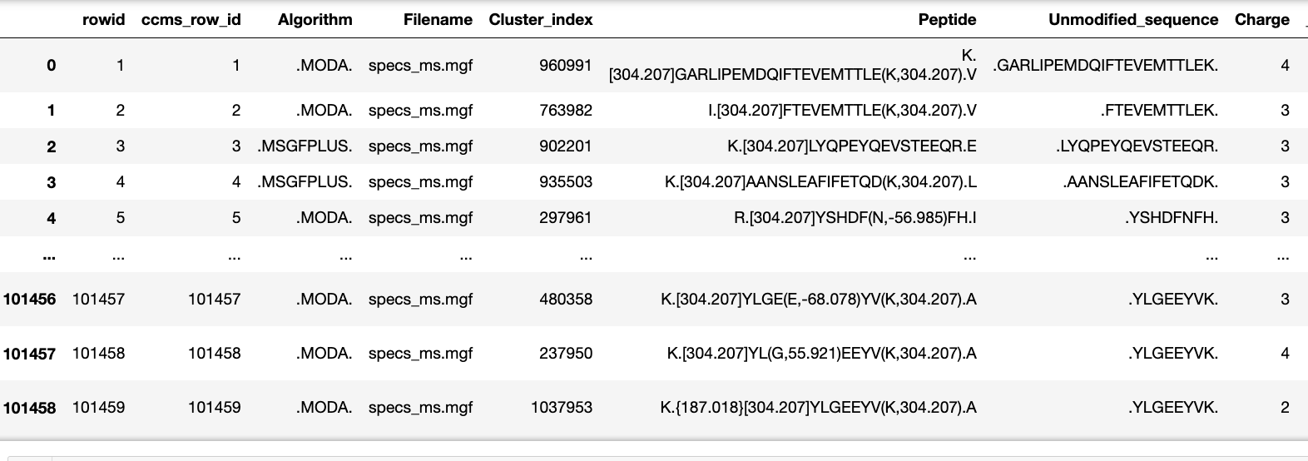
Data Preprocessing
Data Selection: Select columns with intensity for peptide variant
Missing Value Interpretation: Zero values in the processed matrix, which represent peptide intensities, are replaced with N/As.

Slide 4
Data Preprocessing(cont.)
Data Re-organization: The matrix is reorganized so that each peptide is a column, and each row represents a patient sample.
Grouping and Labeling:
Patient samples are grouped into two classes: COVID and NON-COVID.
'COVID' includes non-severe-COVID-19 and severe-COVID-19 patients.
'NON-COVID' includes healthy and symptomatic-non-COVID-19 patients.
These groups are used as labels for classification.

Slide 5
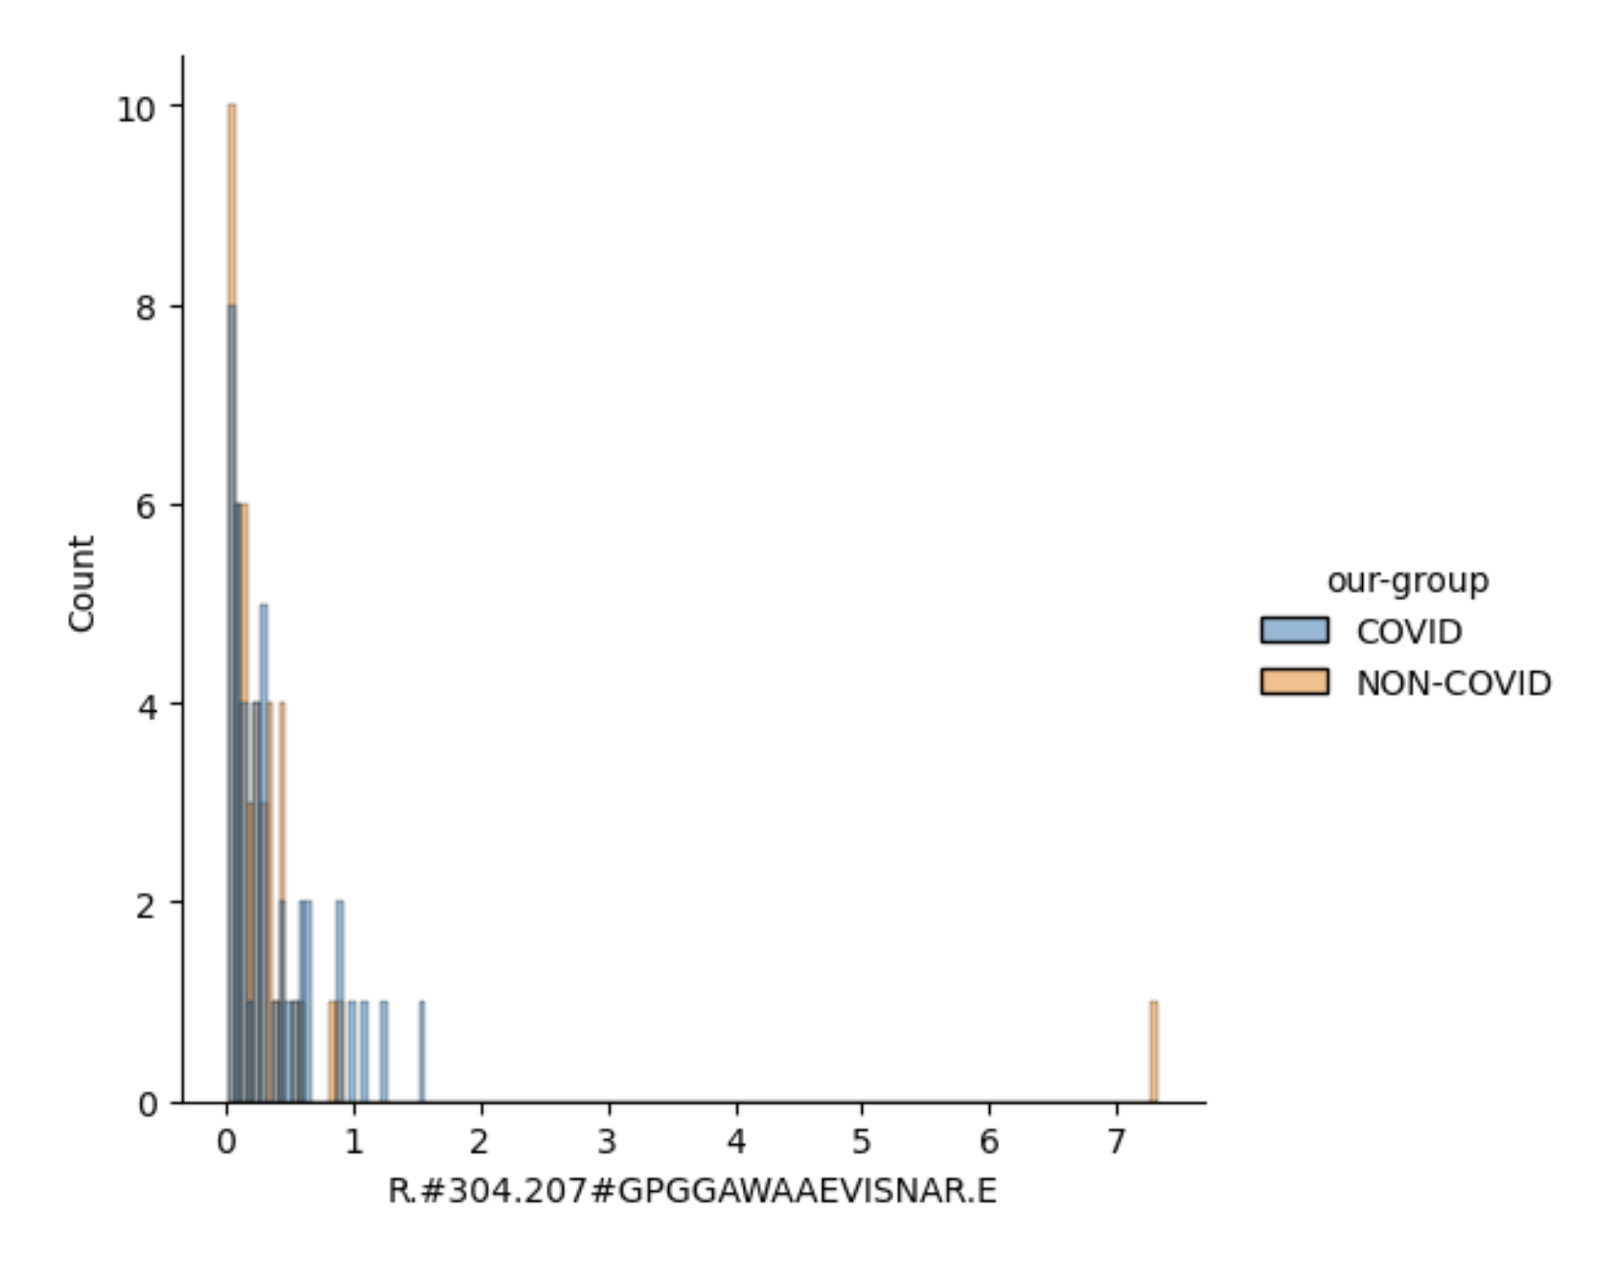
Data Preprocessing - histogram of peptide values
A histogram of peptide values was plotted to visually examine the distribution of peptide "R.#304.207#GPGGAWAAEVISNAR.E",grouped by 'our-group'.

Slide 6
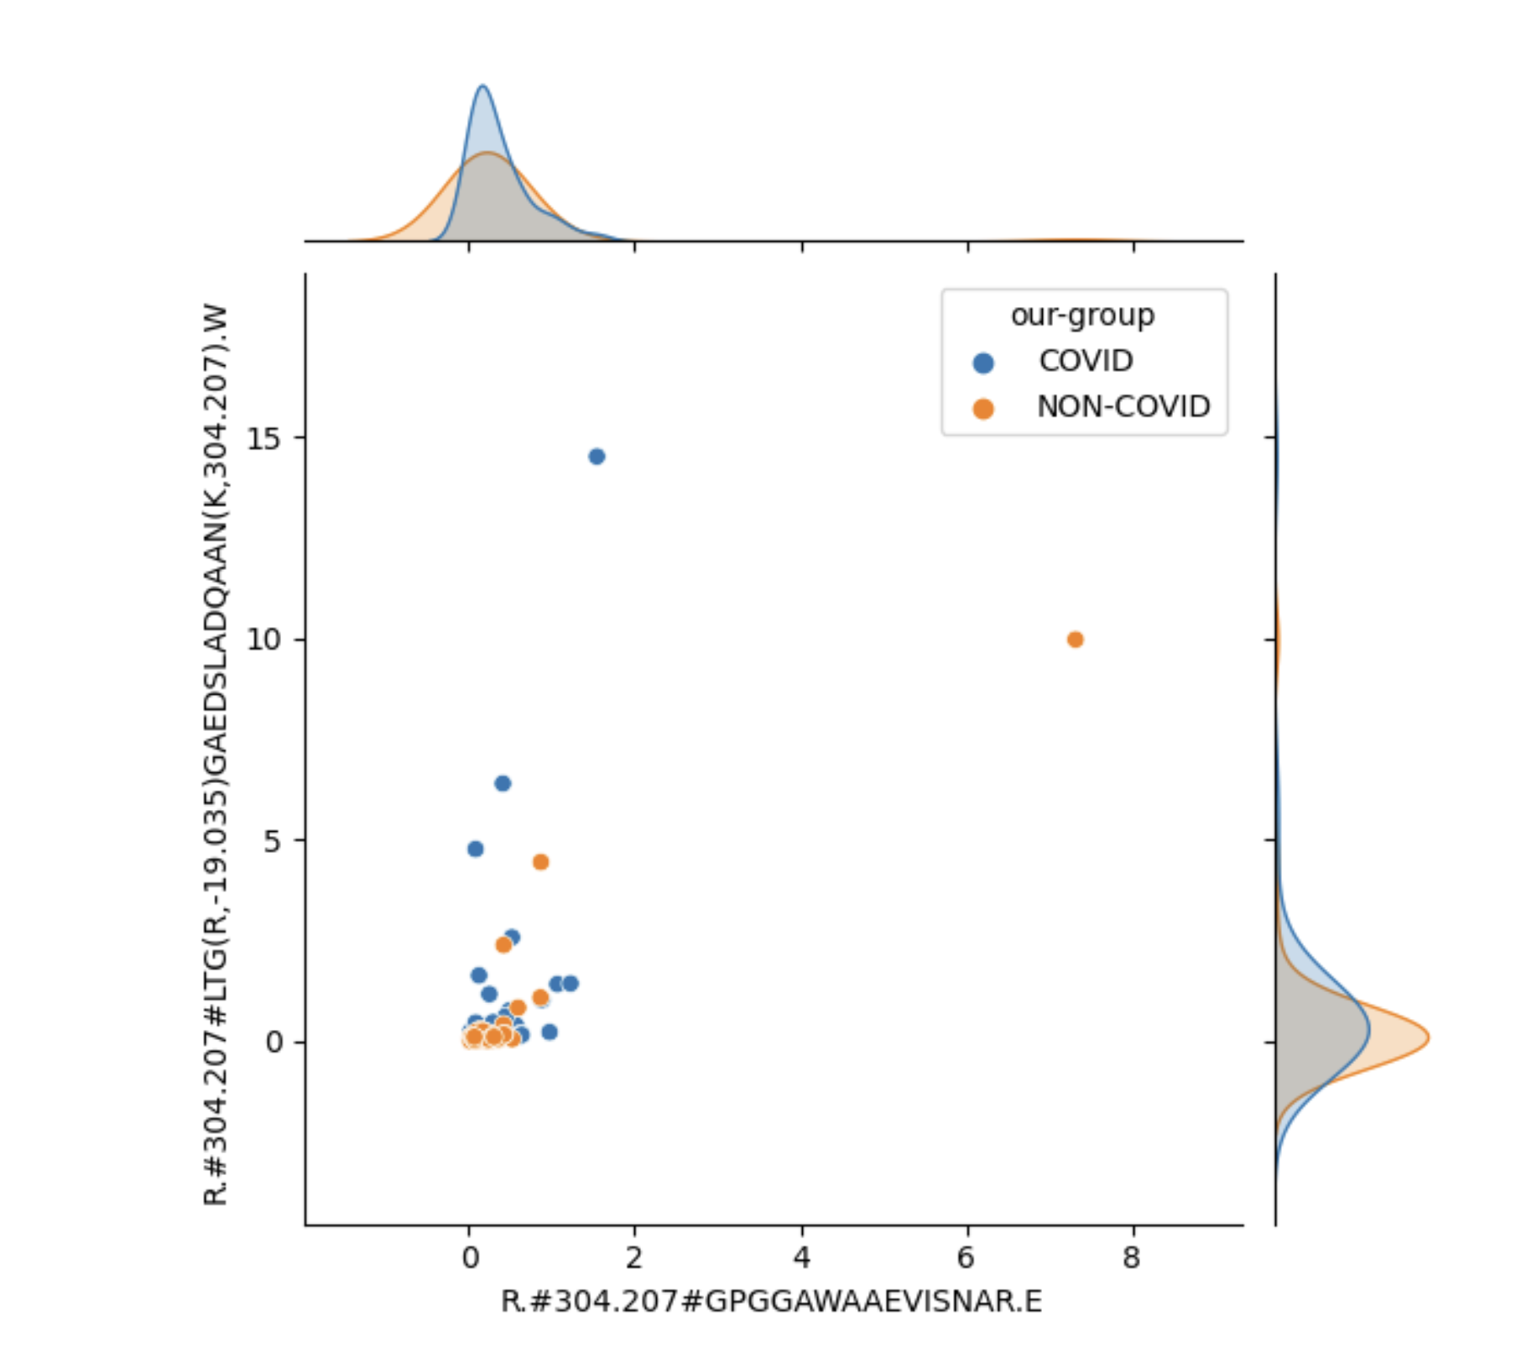
Data Preprocessing - relationship between peptide
2D plot to examine the relationship between the peptide "R.#304.207#GPGGAWAAEVISNAR.E" and "R.#304.207#LTG(R,-19.035)GAEDSLADQAAN(K,304.207).W", separated by 'our-group':

Slide 7
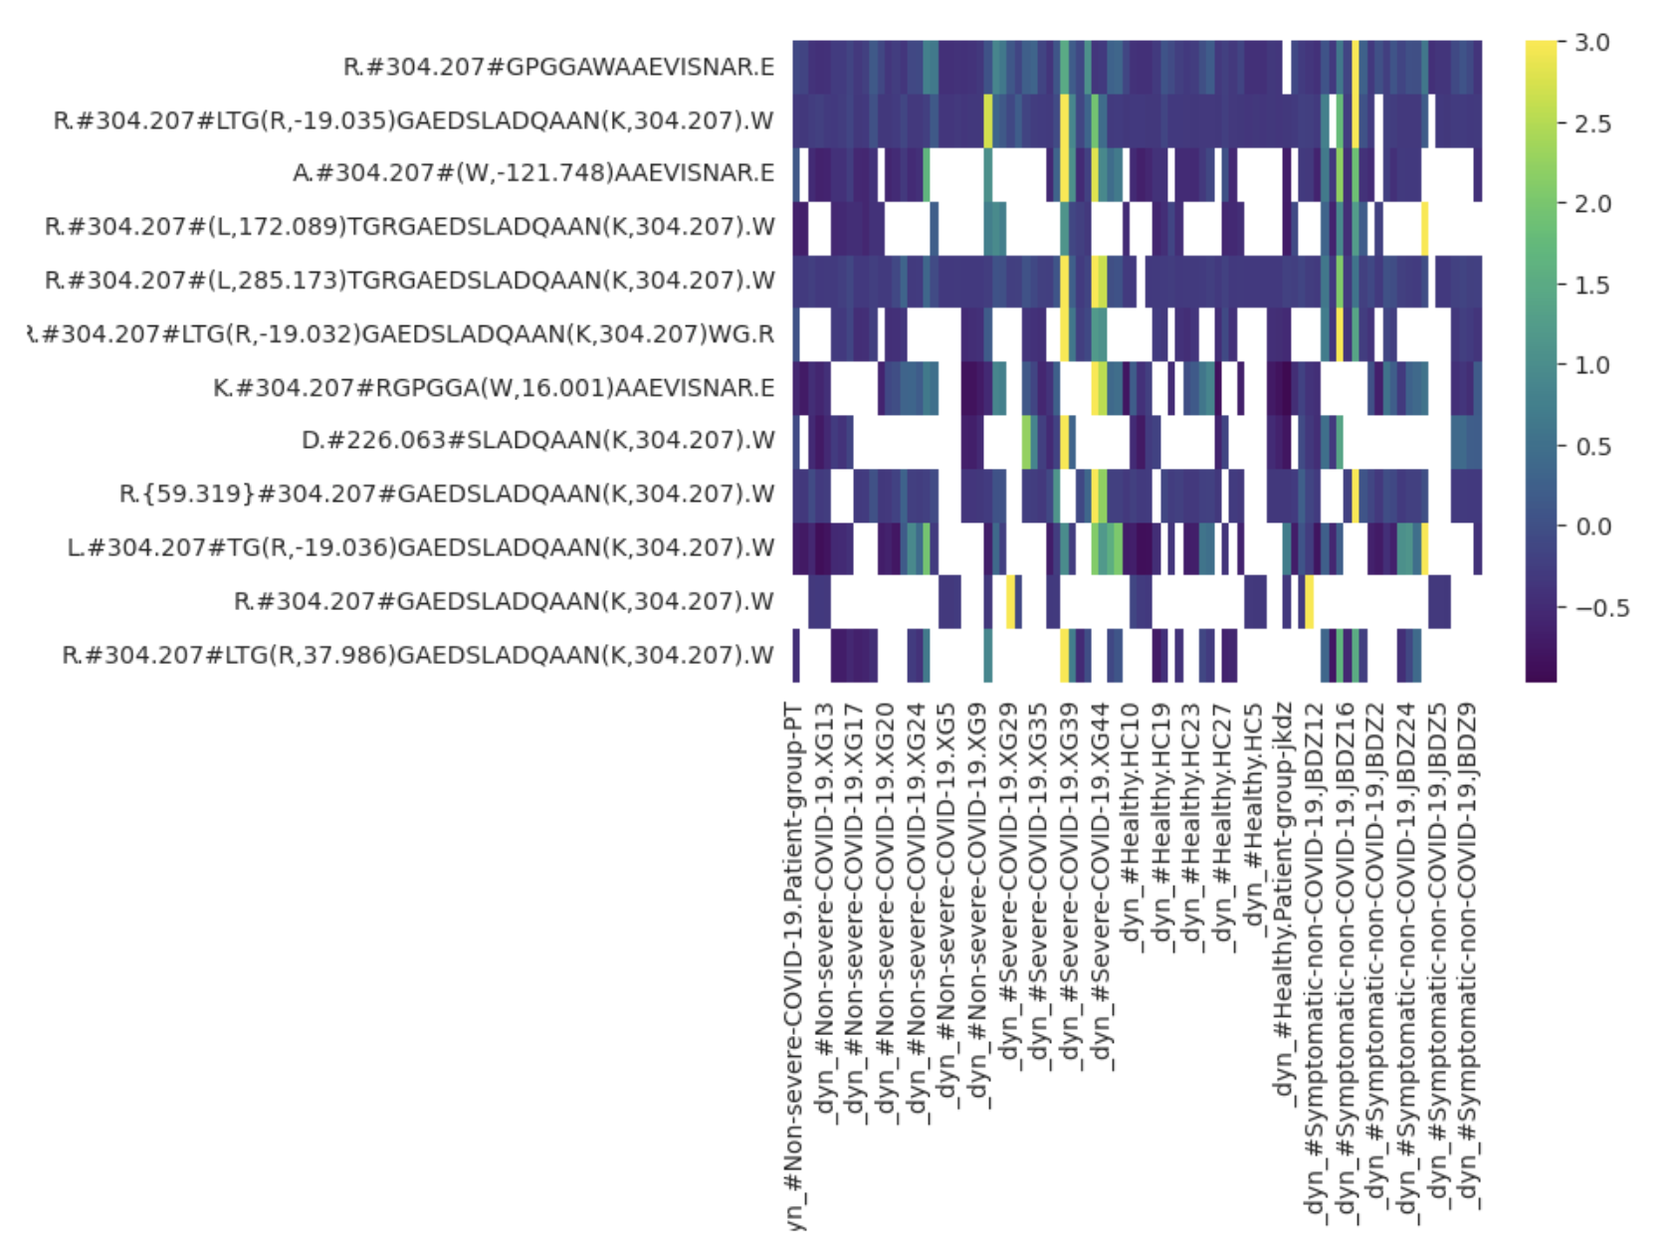
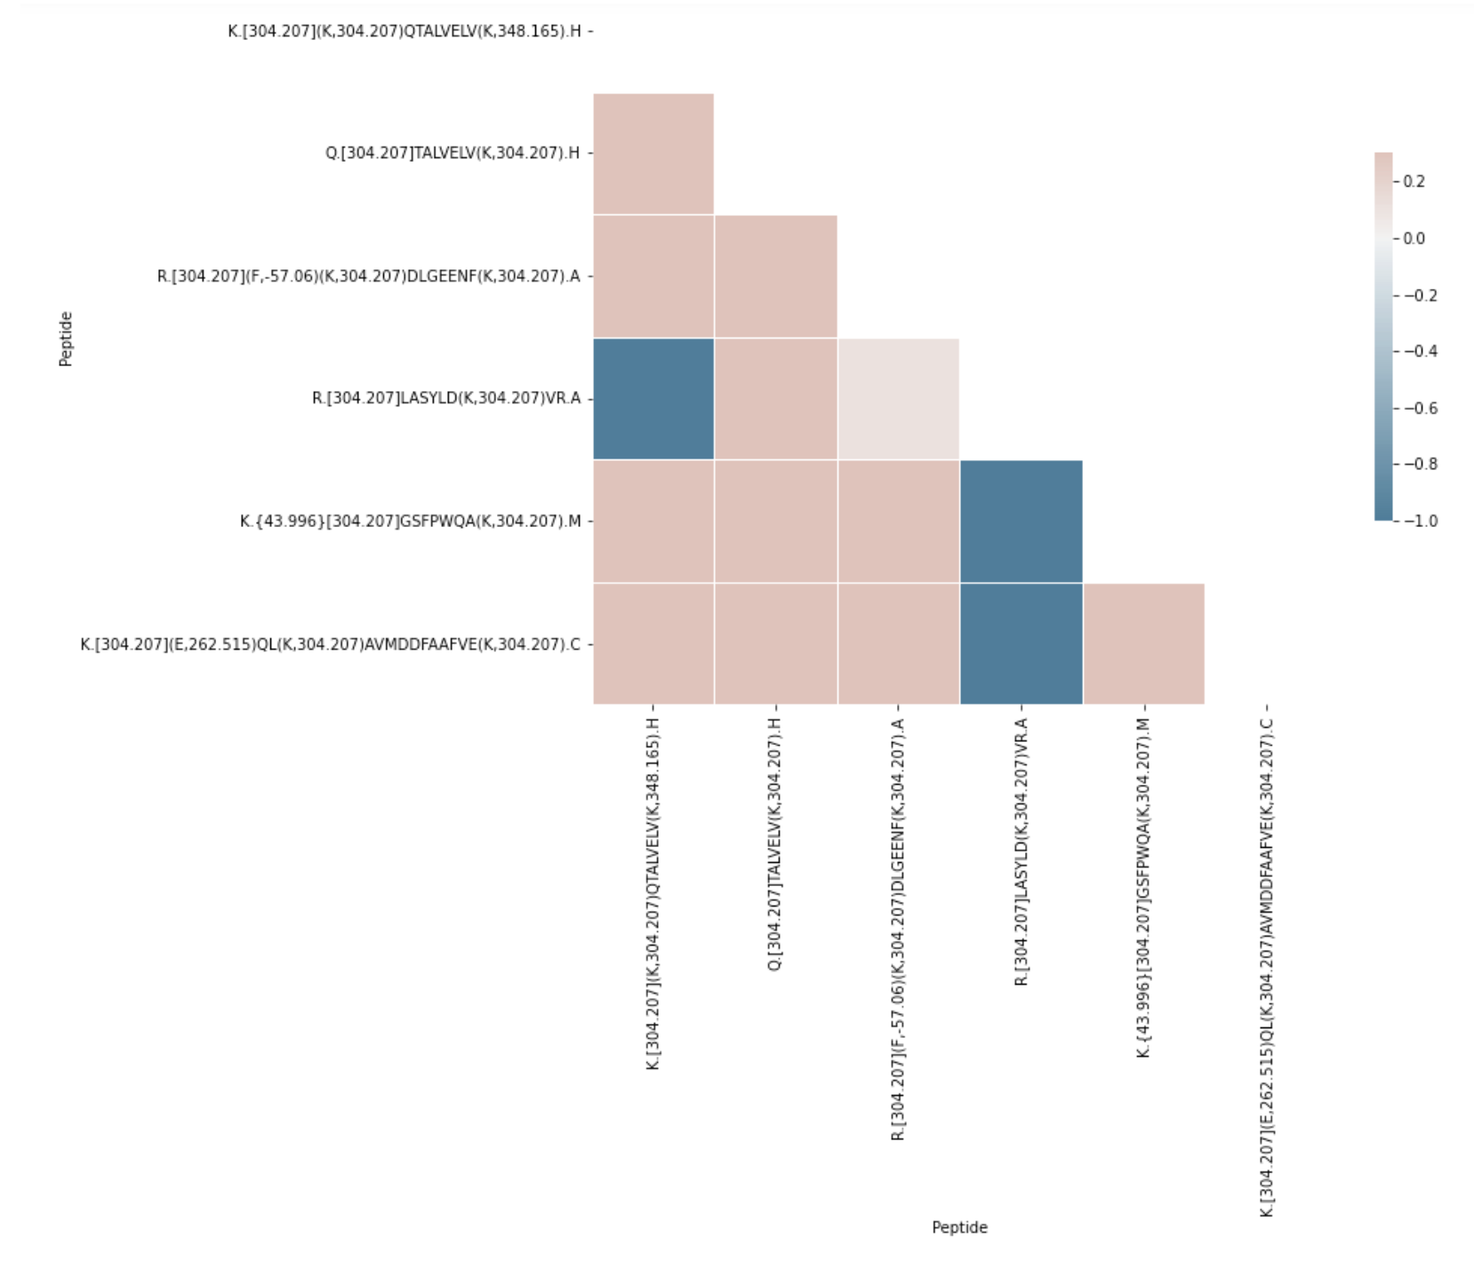
Data Preprocessing - heatmap

Slide 8
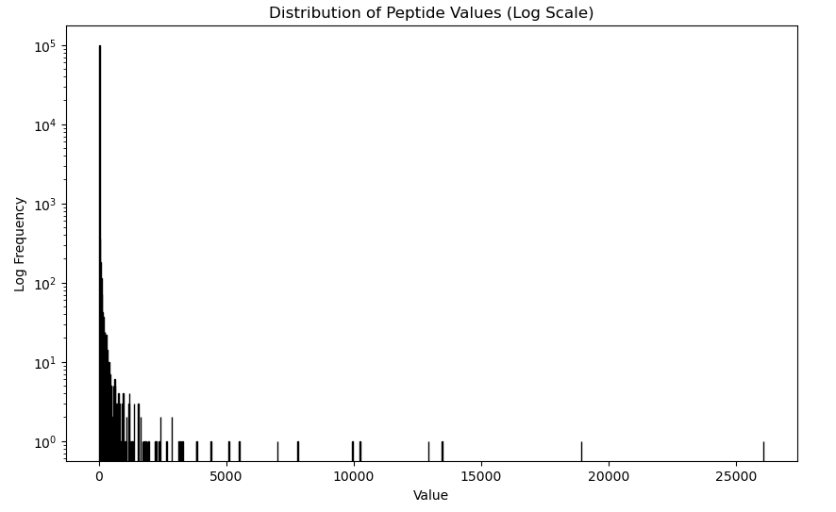
Feature Selection
Variance and correlation of each peptide was calculated to identify potential discriminative features.
The 99.99th percentile of the variants was calculated and used as the threshold for filtering high variance features.
Notes:
Statistical Testing:
T-test and Mann-Whitney rank test were performed to assess whether the means or medians of the two groups (covid and non-covid) are significantly different.
Both tests yielded a p-value significantly higher than the standard 0.05 threshold for statistical significance, indicating that there is no significant difference in the mean or median peptide intensities between the COVID and non-COVID groups.
These findings underscore the complexity of the problem and the need for sophisticated methods like machine learning to tackle it.

Slide 9
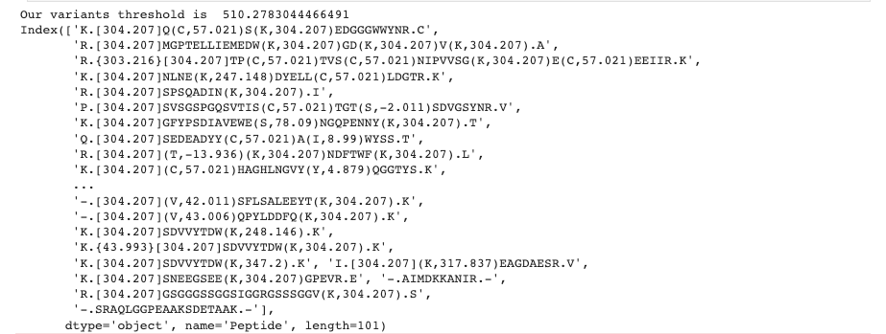
Feature Selection (cont.)
The top 100 peptides with the highest variance were selected as input features.
Final dataset resulted in 90 samples and 104 features, including the label and group features.
Notes:
Statistical Testing:
T-test and Mann-Whitney rank test were performed to assess whether the means or medians of the two groups (covid and non-covid) are significantly different.
Both tests yielded a p-value significantly higher than the standard 0.05 threshold for statistical significance, indicating that there is no significant difference in the mean or median peptide intensities between the COVID and non-COVID groups.
These findings underscore the complexity of the problem and the need for sophisticated methods like machine learning to tackle it.

Slide 10
Dataset Construction
Data Randomization:
To ensure unbiased model evaluation, the dataset was randomized. This process disrupts any inherent order in the data that may artificially inflate the model's performance.
Train/Validation/Test Split:
The randomized data was then divided into training, validation, and testing datasets.
80% of the data was used for training to allow the model to learn the intricate patterns and relationships within the data.
10% was used for validation to fine-tune model parameters and prevent overfitting during the training process.
The remaining 10% was used for testing to evaluate the model's performance on unseen data.

Slide 11
Model Selection
Extreme Gradient Boosting (XGBoost): A decision-tree-based ensemble machine learning algorithm known for its speed, performance, and ability to handle a large number of features.
Random Forest: An ensemble learning method that constructs multiple decision trees, preventing overfitting and handling categorical and numerical data without scaling.
Logistic Regression: A simple yet effective model for binary and multiclass classification, serving as our baseline due to its computational efficiency and interpretability.

Slide 12
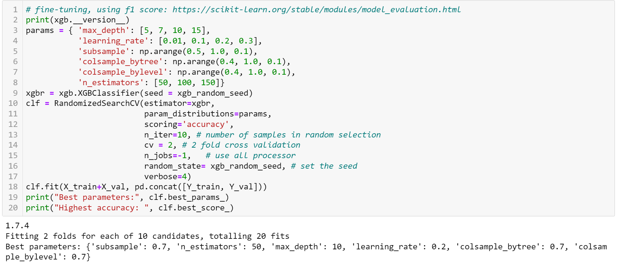
Model Fine-tuning
Notes:
Random search instead of the grid search. Since there are a lot of hyperparameters in XGBoost.

Slide 13
Model results
The model results for 100 features is shown below:
Algorithm | Best Accuracy | Precision | Recall | Accuracy | Balanced Accuracy | F1 Score
Logistic Regression | 0.78 | 1.0 | 0.6 | 0.7778 | 0.8 | 0.75
Random Forest | 0.56 | 0.6 | 0.6 | 0.5556 | 0.55 | 0.6
XGBoost | 0.89 | - | - | - | - | -

Slide 14
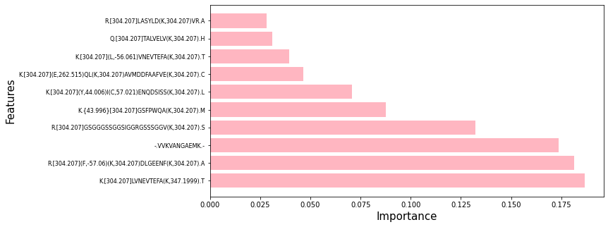
Model results
Based on XGBoost result, we also calculated the important of features

Slide 15
Assessment on Important Features for the Classification
We first identified the top features contributing to the classification task. This was achieved by utilizing the feature importance capability of the XGBoost model.
'K.[304.207](K,304.207)QTALVELV(K,522.33)H(K,304.207).P',
'R.[304.207]SPSQADIN(K,304.207).I',
'Y.[304.207](T,40.489)PGSTVLYR.I',
'N.[304.207](P,52.514)VQRILGGHLDA(K,304.207).G',
'F.[304.207](K,297.16)DLGEENF(K,304.207).A',
'K.[304.207](K,247.155)QTALVELV(K,304.207).H',
'R.[304.207](F,-57.06)(K,304.207)DLGEENF(K,304.207).A',
'K.[304.207](K,247.144)VPQVSTPTLVEVSR.N',
'R.[304.207]ETQSQLETER.S',
'K.[304.207](L,-57.061)VNEVTEFA(K,304.207).T'
Notes:
Introduction: In this section of the analysis, we assessed the features to understand their importance for classification and correlation with the target classes. This process helps us understand which attributes of the data are most predictive and gives us insight into the underlying patterns in the data.

Slide 16
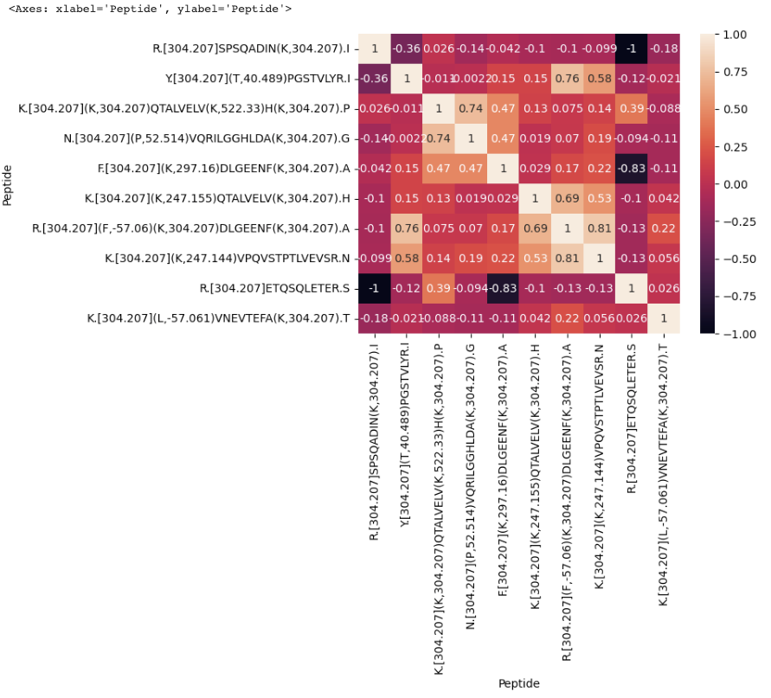
Assessment on Important Features for the Classification (cont.)
To assess how well these important features (or groups of features) correlate with the target classes, we calculated the correlation matrix between these top 10 features and the target variable 'Condition'.
Notes:
Introduction: In this section of the analysis, we assessed the features to understand their importance for classification and correlation with the target classes. This process helps us understand which attributes of the data are most predictive and gives us insight into the underlying patterns in the data.

Slide 17
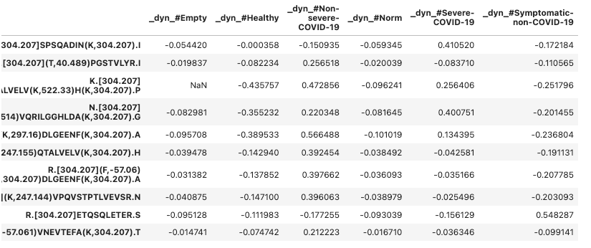
Assessment on Important Features for the Classification (cont.)
To support our evaluation of the quality of the selected important features, we further examined the correlation of each feature with each class in the target variable. This involved One-Hot encoding the target variable to create binary columns for each class.
Notes:
Introduction: In this section of the analysis, we assessed the features to understand their importance for classification and correlation with the target classes. This process helps us understand which attributes of the data are most predictive and gives us insight into the underlying patterns in the data.

Slide 18
Assessment on peptide/variant identification
Introduction: This assessment focused on confirming the spectrum identification of the top features and understanding the impact of modifications on peptide spectra.
Top Features: The top five peptides identified in our model were:
'R.[304.207]SPSQADIN(K,304.207).I'
'Y.[304.207]PGSTVLYR.I'
'K.[304.207]QTALVELV(K,522.33)H(K,304.207).P'
'N.[304.207]VQRILGGHLDA(K,304.207).G'
'F.[304.207]DLGEENF(K,304.207).A'
Confirmation of Spectrum Identification: To validate the spectrum identification for these top peptides, we compared their spectral peaks with reference spectra from the MassIVE database. A high cosine similarity score provides strong evidence for correct identification.

Slide 19
Assessment on peptide/variant identification
Relation of Modified Peptides to Unmodified Spectra: Modifications can significantly alter the spectra of peptides. For the top five modified peptides, we evaluated the relationship between their spectra and the spectra of their unmodified counterparts. We focused on comparing the peak patterns and cosine similarity.

Slide 20
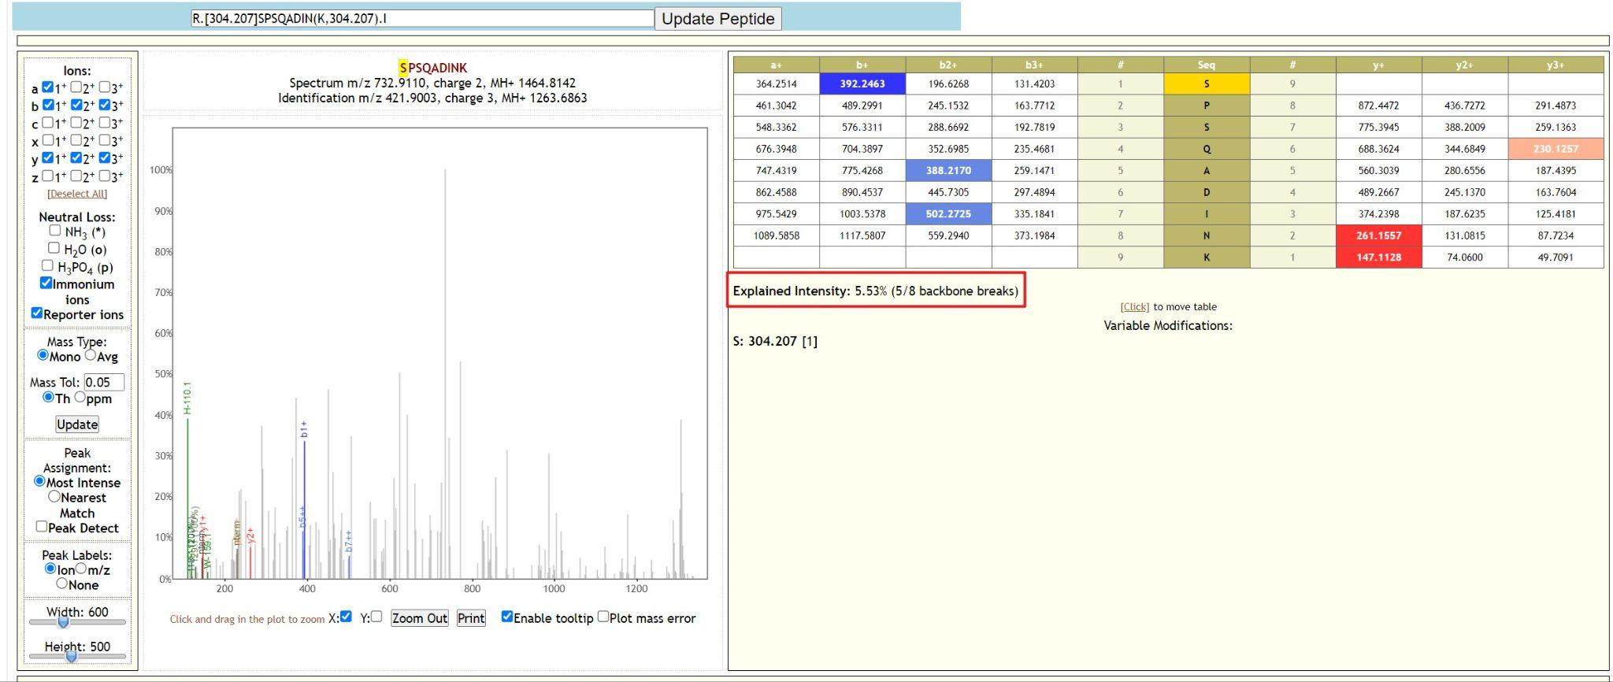

Slide 21
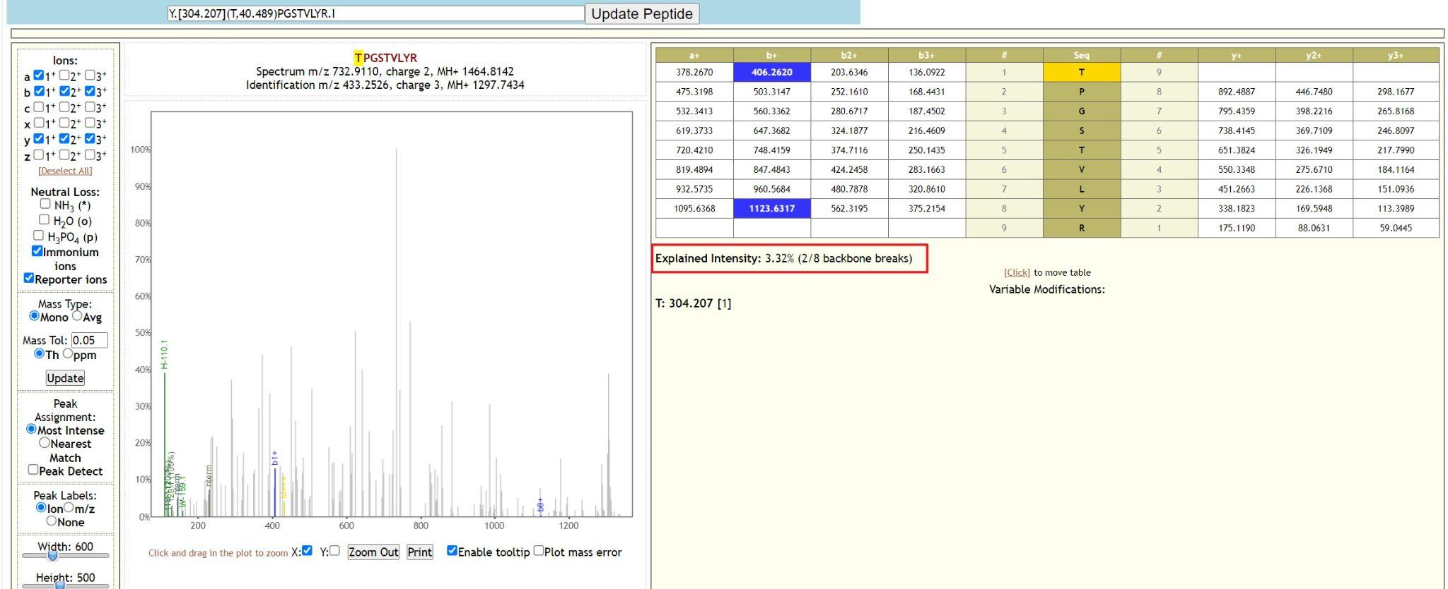

Slide 22
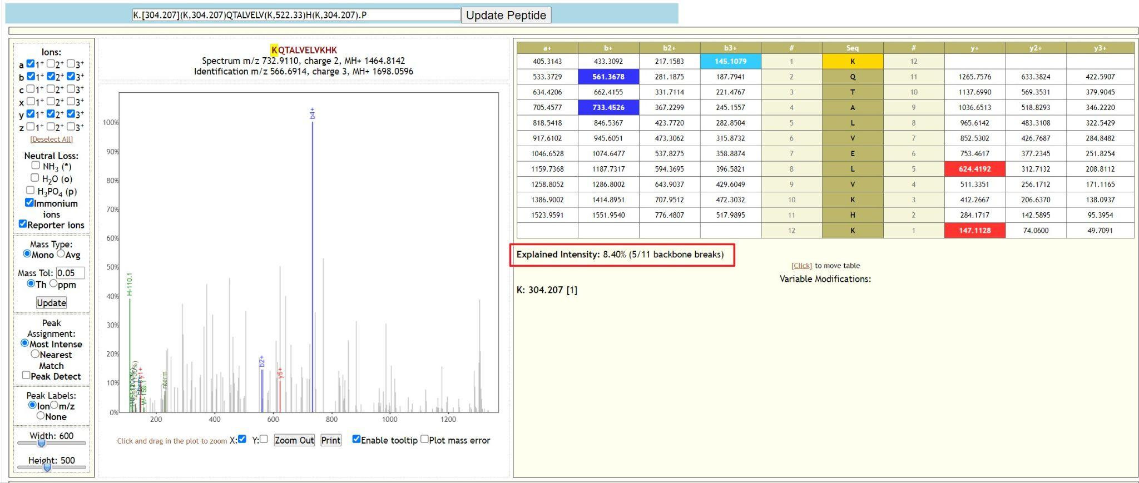

Slide 23
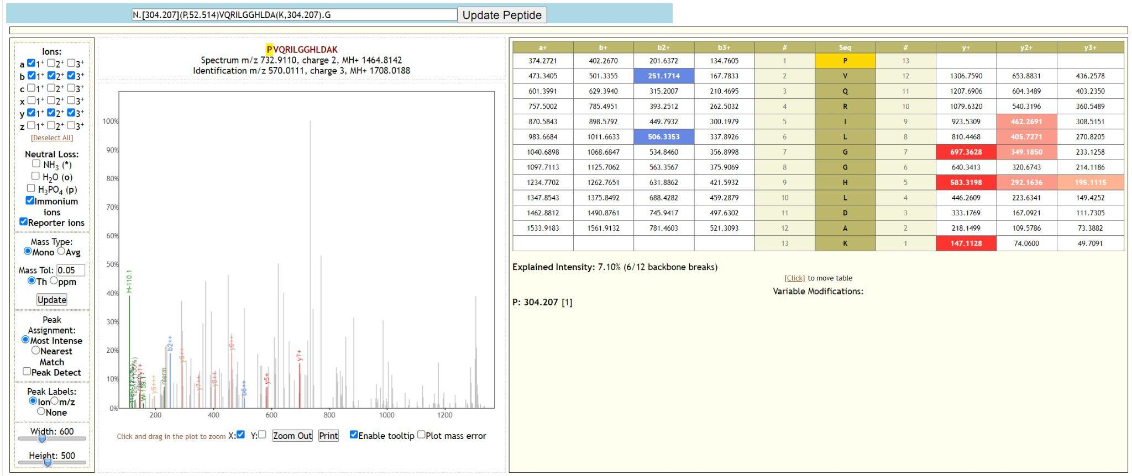

Slide 24
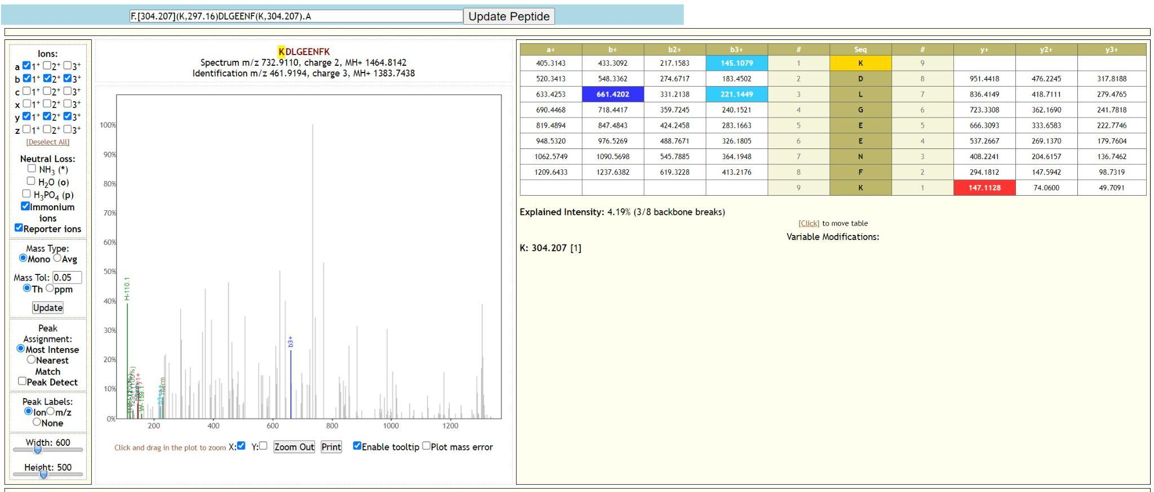

Slide 25
Assessment on Protein Identification
Objective: To examine the relationships between peptides identified in the peptide identification assessment phase and their related proteins using top 5 peptides from proteomics data.
Bipartite Graph: Visual representation of peptide-protein mapping. Nodes on the left represent peptides, on the right - proteins. Edges represent peptide's presence in a protein.
Findings:
Unique peptide-protein match: 'Y.304.207PGSTVLYR.I' with 'sp|P01024|CO3_HUMAN'. High certainty in identification.
Seven proteins identified with multiple peptides. Increases reliability of protein identification.

Slide 26
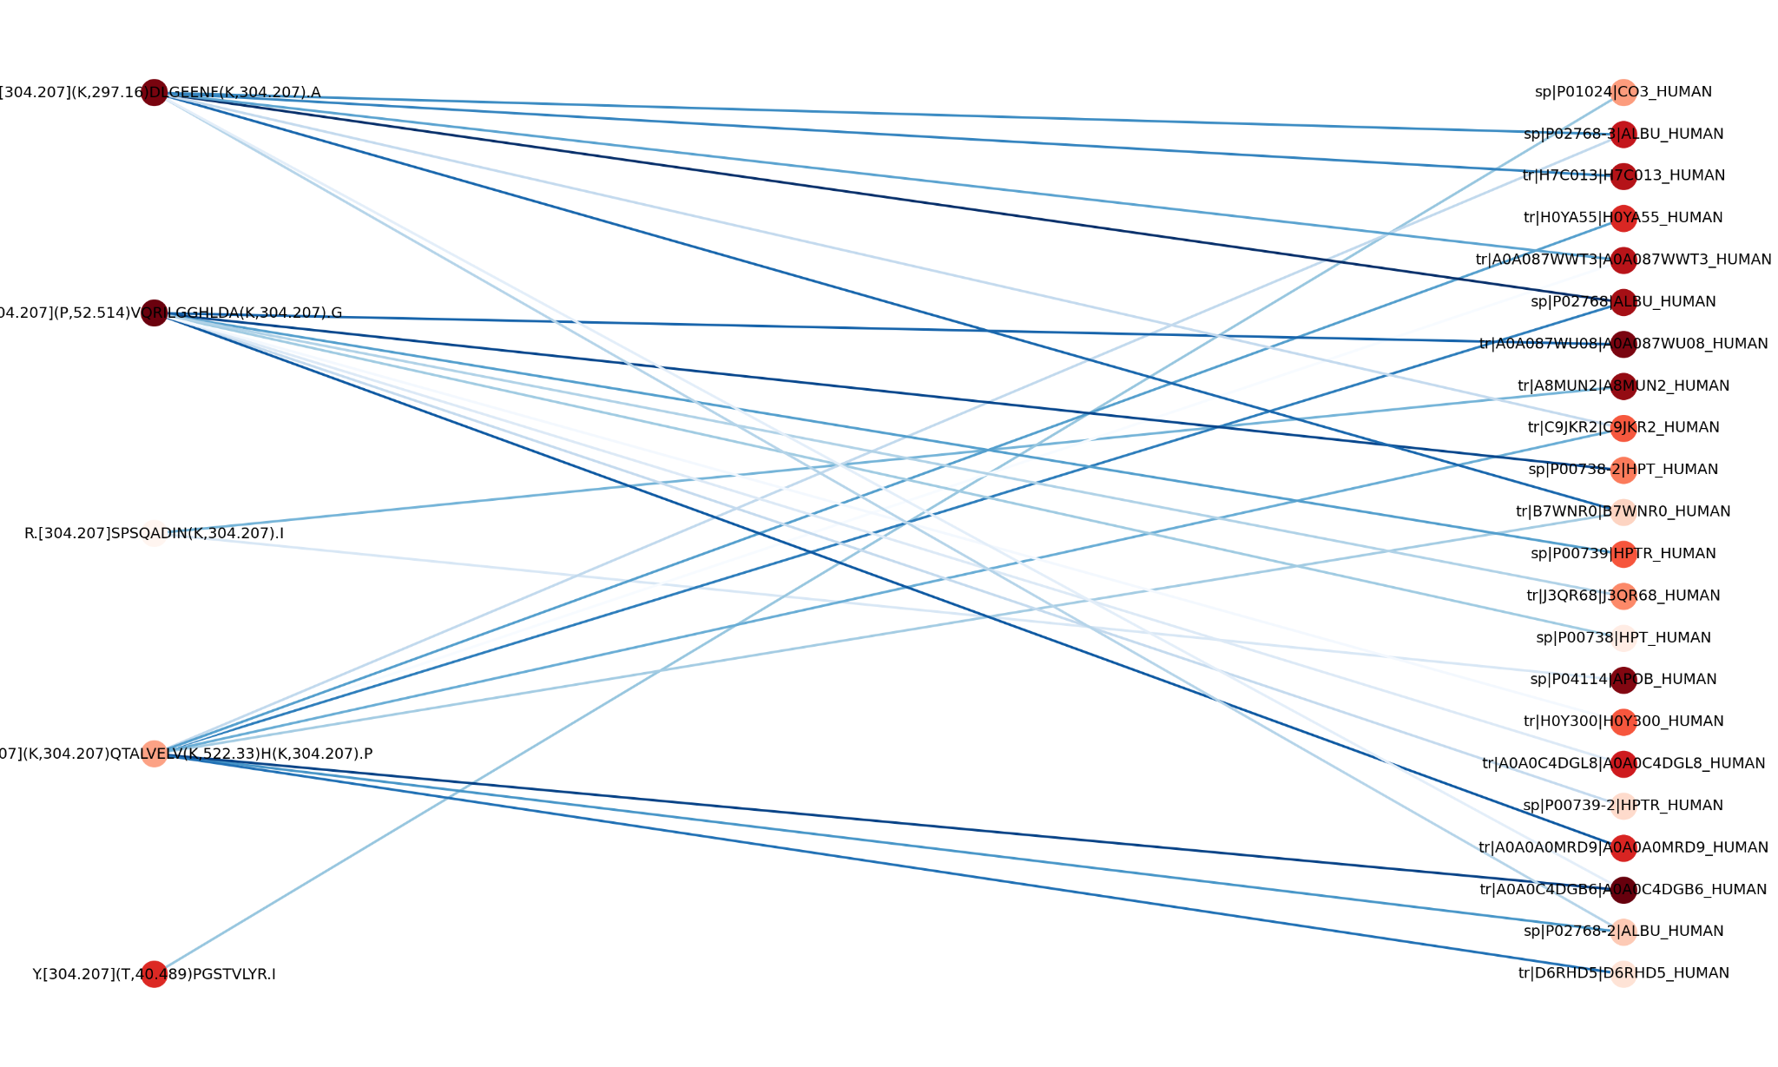

Slide 27
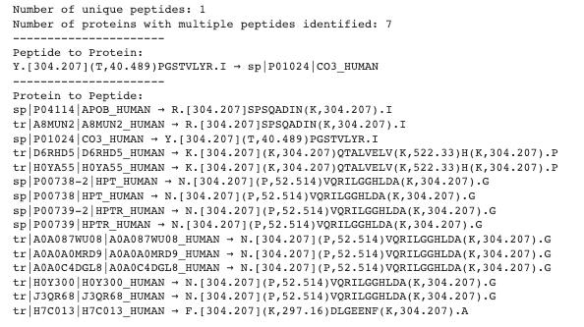
Assessment on Protein Identification (cont.)

Slide 28
Q&A

